Slide 1


Analytical Report on Social Buzz

Slide 2


Today's agenda
Project recap
Problem
The Analytics team
Process
Insights
Summary

Slide 3

Social Buzz is a fast growing technology unicorn that need to adapt quickly to its global scale. Accenture has begun a 3 months POC focusing in these tasks :
Project Recap
An audit of Social Buzz’s big data practice.
Recommendations for a successful IPO.
Analysis to find Social Buzz’s top 5 most popular categories of content.

Slide 4

Problem
Over 100000 posts per day
36,50,0000 pieces of content per year !
But how to capitalize on it when there is so much
Analysis to find Social Buzz top 5 popular categories of content

Slide 5


Andrew Fleming(Chief Technical Architect)
The Analytics team
Marcus Rompton(Senior Principle)
Myself(Data Analyst)

Slide 6
Process
1
Data Understanding
2
Data Cleaning
3
Data Modeling
4
Data Analysis
5
Brief Insights

Slide 7
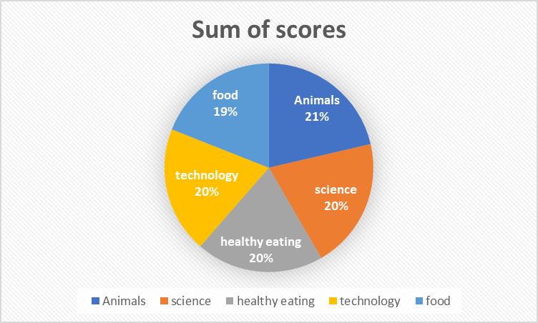
Insights
Based on the given data below we can see the top 5 categories with highest popularity. Out of which “Animal” being the highest among them all and vice versa as follows.
1897
Reactions to “Animal” Posts
Category | Sum of scores
Animals | 74965
science | 71168
healthy eating | 69339
Technology | 68738
food | 66676

Slide 8


We can summarize from the given data that, a total of 16 distinct content categories. The aggregate scores reveal which categories resonate most with the audience.
Top-performing categories include Animals (74,965), Science (71,168), and Healthy Eating (69,339), indicating high levels of user engagement.
Other strong categories are Technology (68,738), Food (66,676), and Culture (66,579), suggesting a wide interest in both lifestyle and informational content.
Lower-engaging categories include Veganism (49,619) and Public Speaking (49,264), which may represent niche interests or areas with potential for growth.
This analysis provides clear insight into user preferences and can help guide content strategy and prioritization moving forward.
Summary

Slide 9
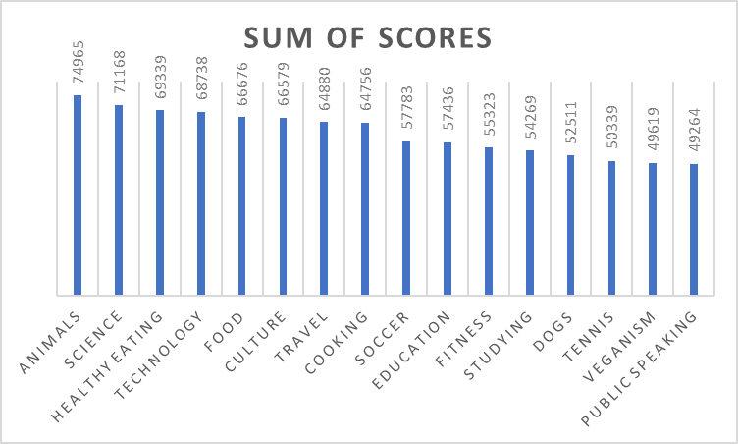
Insights
After a thorough analysis of the cleaned dataset containing the columns: Content ID, Reaction Type, Category, Scores, and Sentiments, it was found that there are a total of 16 content categories, each with the following aggregate scores:
January
Highest no. of posts

Slide 10
Thank you!
ANY QUESTIONS?

